Slide 1






CSCI-E-109b Advanced Data Science
2022 Spring Final Project
Andrew Welsh
ALM Data Science
Michael Streyle
ALM Data Science
Jon Thompson
ALM Data Science
Jack Tsu
ALM Data Science
Notes:
Andrew

Slide 2
CSCI-E-109b Advanced Data Science
2022 Spring Final Project
Detecting Near Earth Objects (NEOs)
Notes:
Andrew

Slide 3
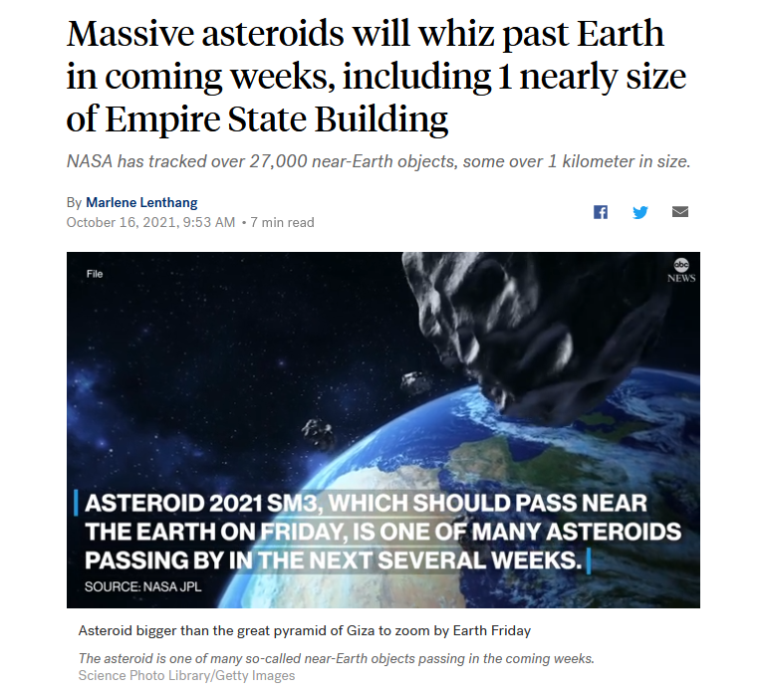


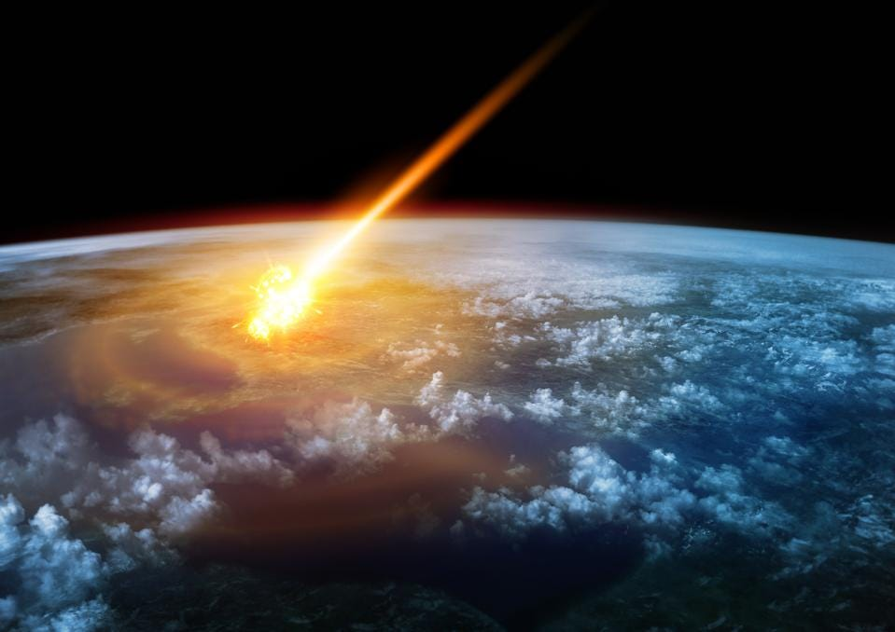


Motivation
NEOs in Media
Notes:
Andrew

Slide 4
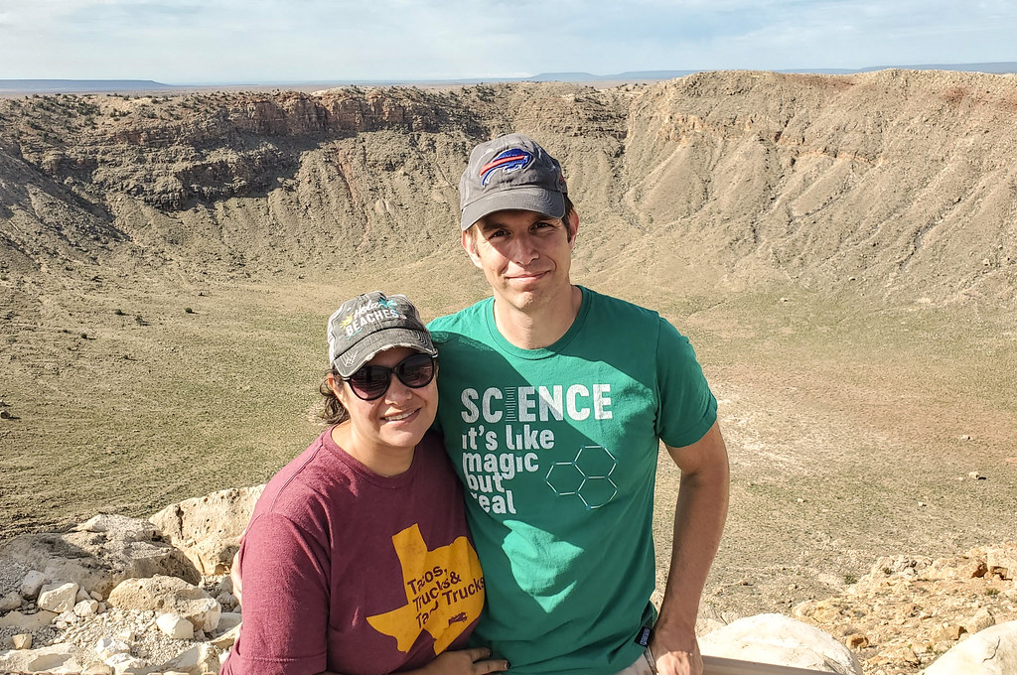
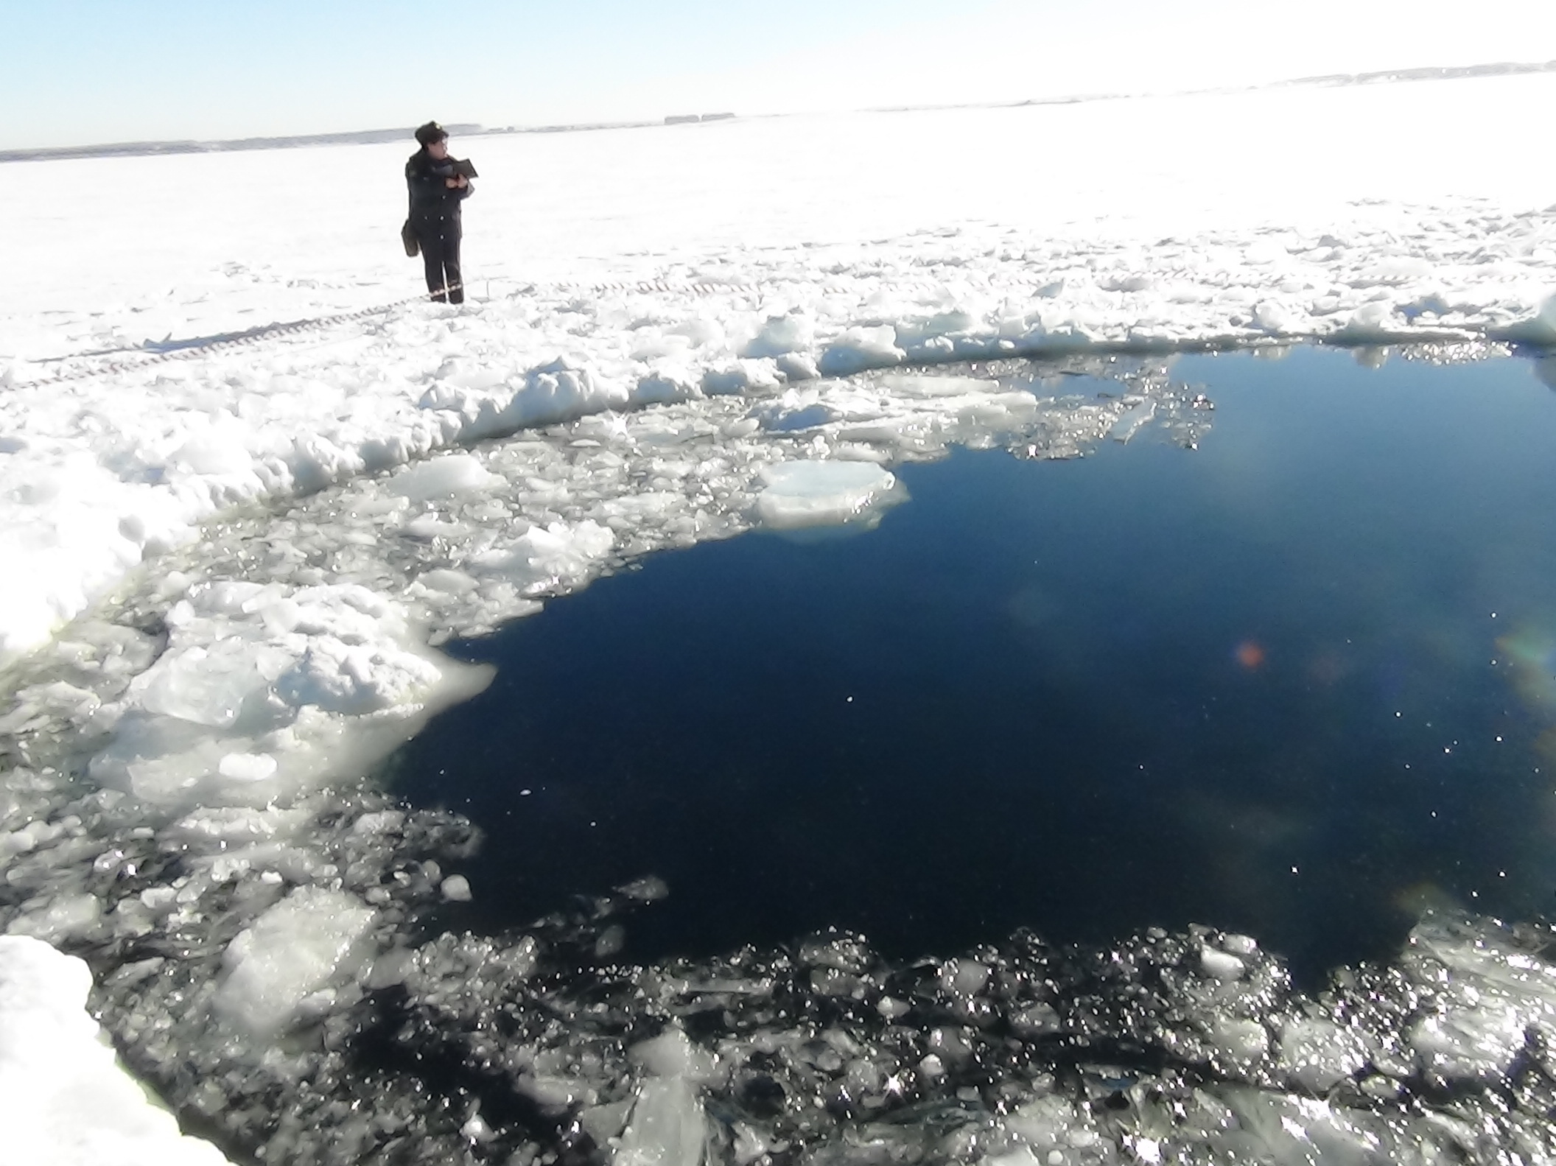
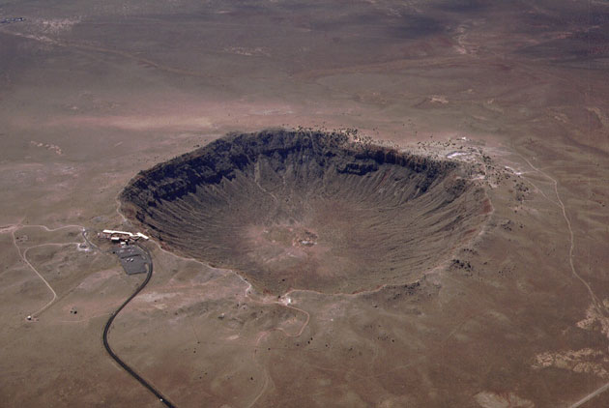
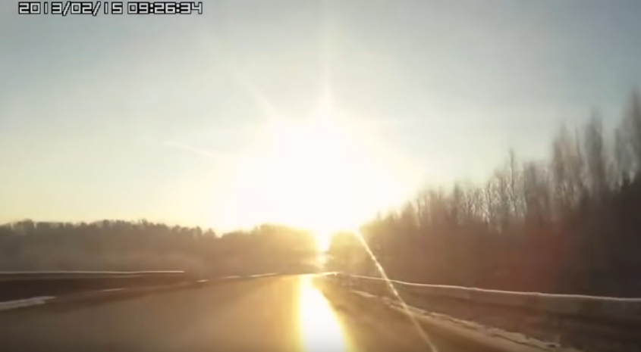
Motivation
What is the danger of Near Earth Asteroids?
Chelyabinsk, Russia, Fri. 15 Feb 2013, 9:26am
~400-500 kiloton explosion at 30km altitude (~30x Hiroshima)
~20m asteroid
1,500 injured, $33M in damages
Barringer Meteor Crater, Arizona
50,000 years ago
~50m asteroid
~10 Megaton explosion
1.2km diameter crater
I seen’t it!
(That’s not the sun)
Notes:
Andrew

Slide 5
Motivation
Congressional charter: Find and track 90% of potentially hazardous asteroids (PHA’s) 140m+ in diameter
Discoveries reported to Minor Planet Center (MPC) of the Smithsonian Astrophysical Observatory at Harvard University
Multiple Sky surveys – our data comes from these two:
ATLAS Project
JPL Horizons
Notes:
Andrew

Slide 6
What Could We Model?
Detection of objects in image
Classify objects as PHAs or not
Notes:
Andrew

Slide 7
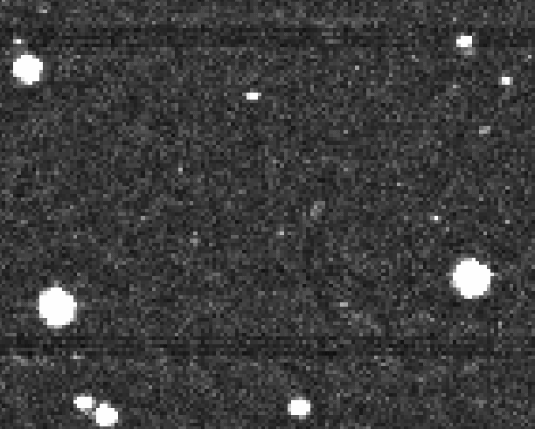
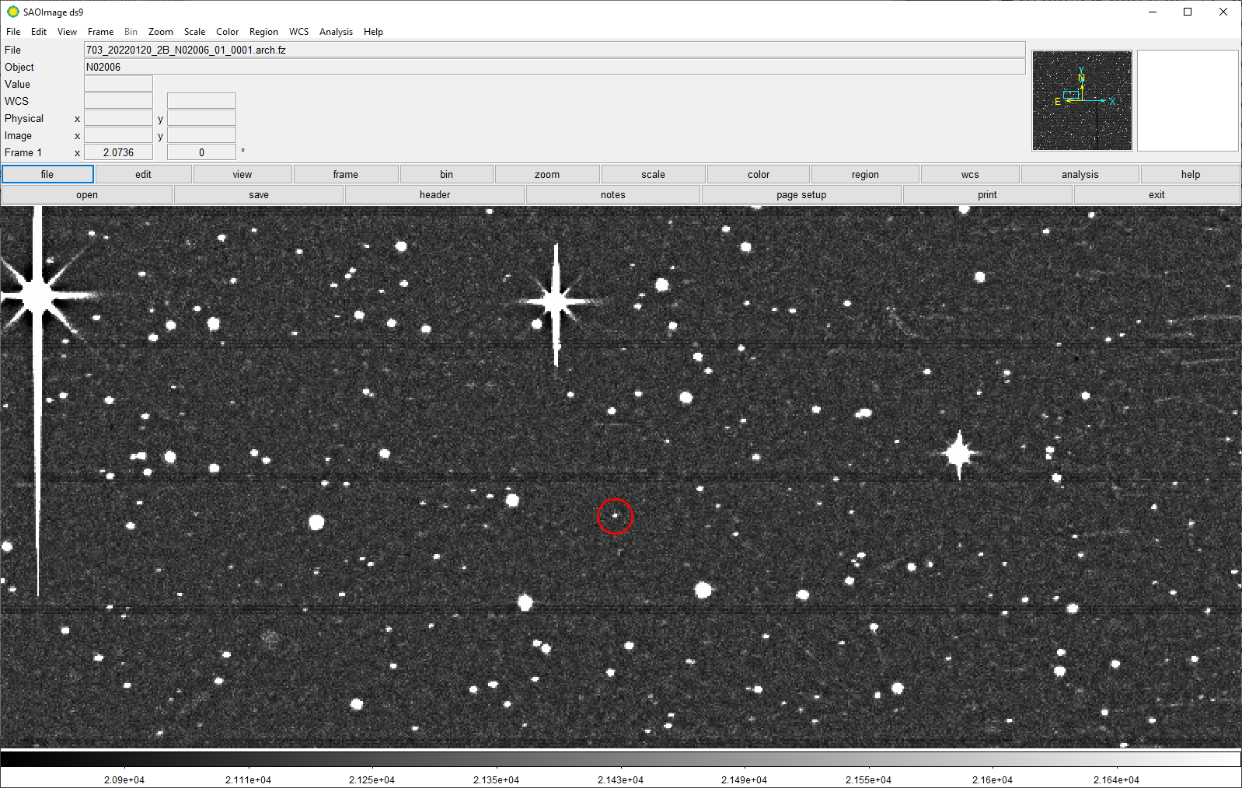
Object detection workflow
Basic approach: Find the differences between 2 images
Find moving objects akin to “blink” method (invented in 1904, how Pluto was discovered)
Tag object’s centroid in each individual image for orbital parameter determination (RA, Dec, velocity between frames)
Notes:
Michael

Slide 8
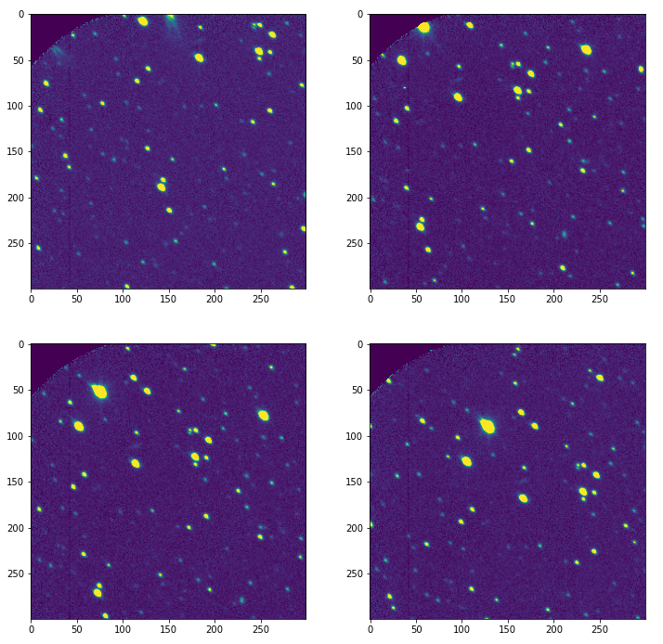
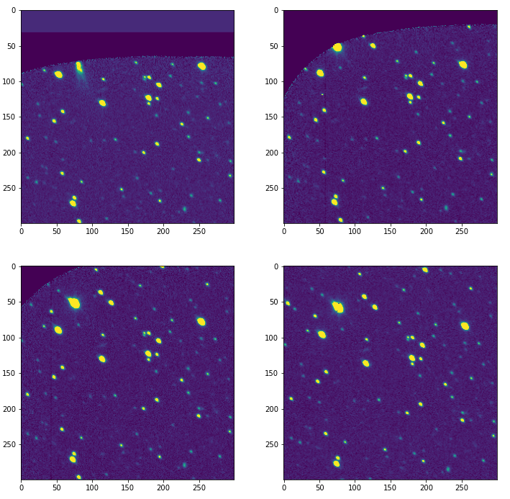
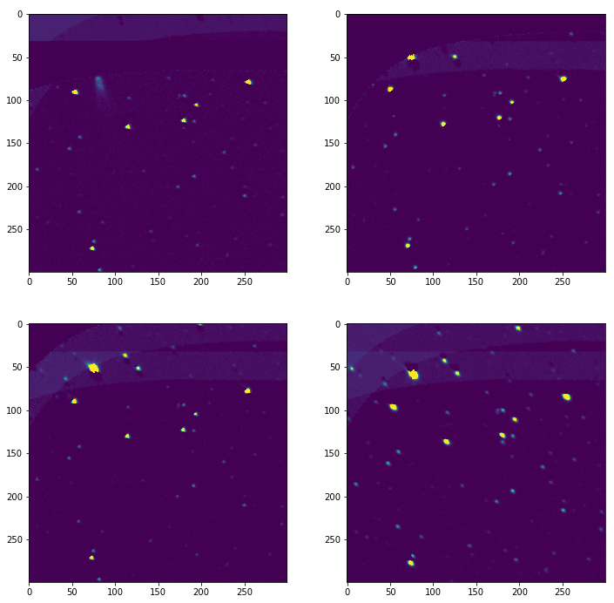
Object detection workflow
Compare two images and find the differences
Align images in sequence
Calculate average of all images
Subtract average from individual image
Classify what is a moving object from frame-to-frame vs noise / artifact
Diff from mean:
not quite aligned!
Original
Aligned
Notes:
Michael

Slide 9
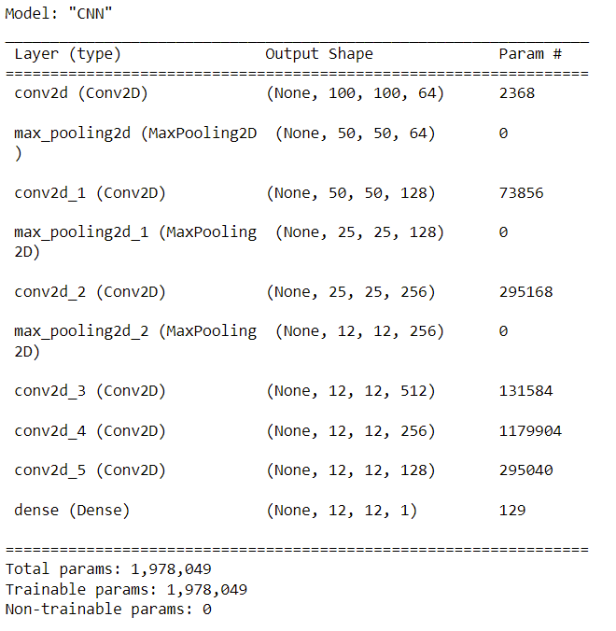
Object Detection Lessons Learned
Image alignment was not always accurate
Attempted (unsuccessfully) a CNN to view images and detect asteroids.
Decided to focus on the PHA prediction to prioritize follow up observations
Notes:
Jon

Slide 10
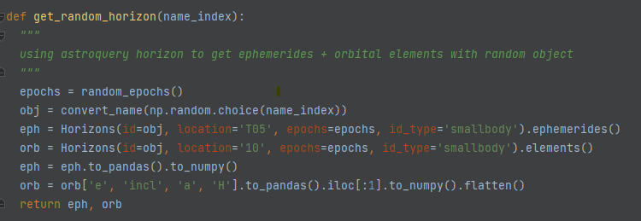
Data Cleaning & Prep
Data generator from JPL Horizons data: 30,000 Observations
Unlimited Variations/Augmentations
JPL Smallbody Database to train MOID model: >1 Million Observations
Notes:
Jon

Slide 11
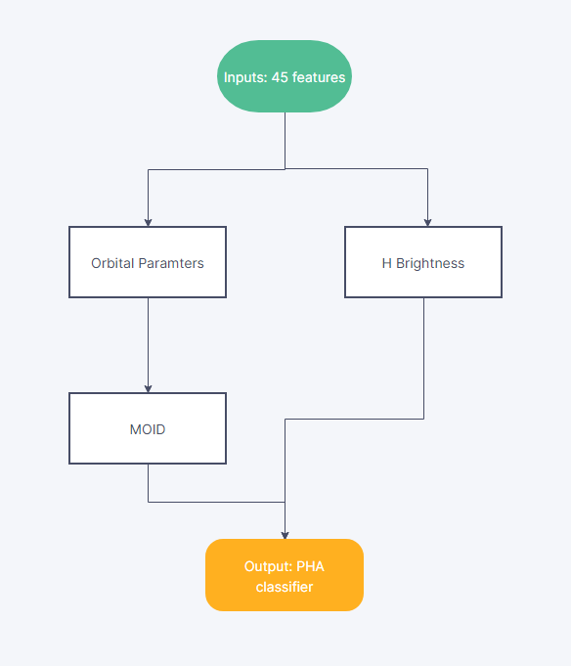
Classifier Overview
Ensemble of 4 models:
Predict 3/6 Orbital Parameters
Predict H
Predict Minimum Orbit Intersection Distance (MOID)
PHA Classifiers
Notes:
Jack

Slide 12
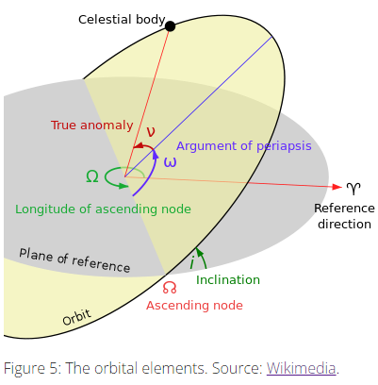
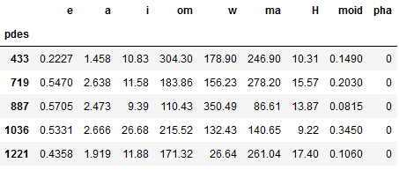
Orbital Regressor
Goal: Predict the shape of ellipse/orbit
Trained Data: JPL Horizon Ephemerides
Input: 45 features w/ Boruta selection
Output: 3 orbital parameters (E, A, I)
Notes:
Jack

Slide 13
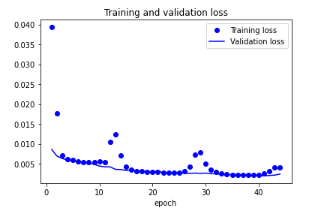
H Regressor
Goal: Predict brightness as proxy for size
Trained Data: JPL Horizon Ephemerides
Input: 45 features w/ Boruta selection
Output: H
Performance: MSE of 0.16
Notes:
Jack

Slide 14
MOID Regressor
NN Regression Model for Minimum Orbit Intersection Distance (MOID) based on earlier modeling of orbital parameters {e, a, i}
Test MSE: 0.023
Notes:
Jon

Slide 15
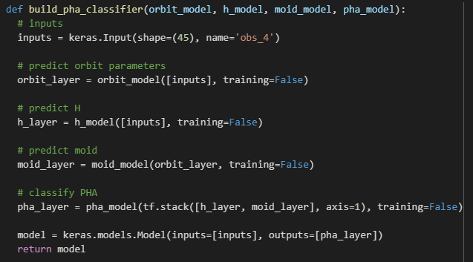
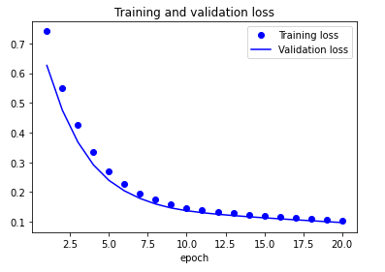
PHA Classifier
Using H and MOID, predict PHA or not
- Training Data: JPL Smallbody database
Performance:
99% AUC if orbital parameters are provided
76% AUC if orbital parameters are modeled from 4 obs
Stack previous models as different layers
Notes:
Jack

Slide 16
Conclusion
Smaller objects may only give us a week or two of notice time, so rapid decision making is important.
Our PHA Classifier can help expedite this search by prioritizing the potentially hazardous objects needing urgent follow-up observations
Notes:
Andrew

Slide 17
Thank You!

